Slide 1
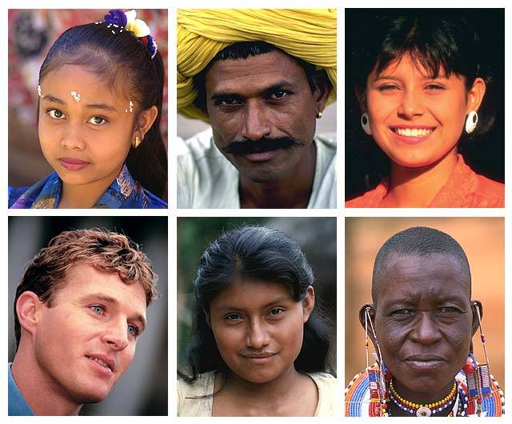
Culture
As it relates to research.

Slide 2

Culture & Research
In this section we will be looking at culture and how it relates to research.

Slide 3
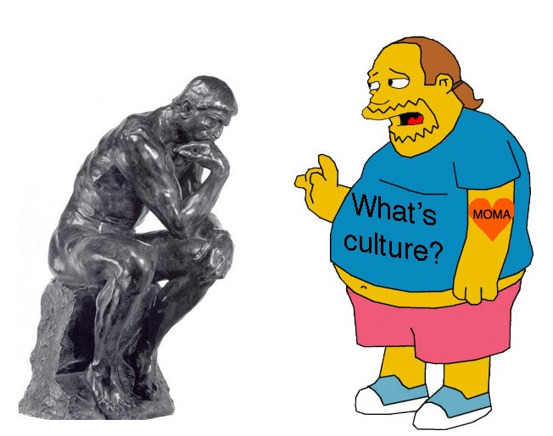
Culture & Research
So what is culture?

Slide 4
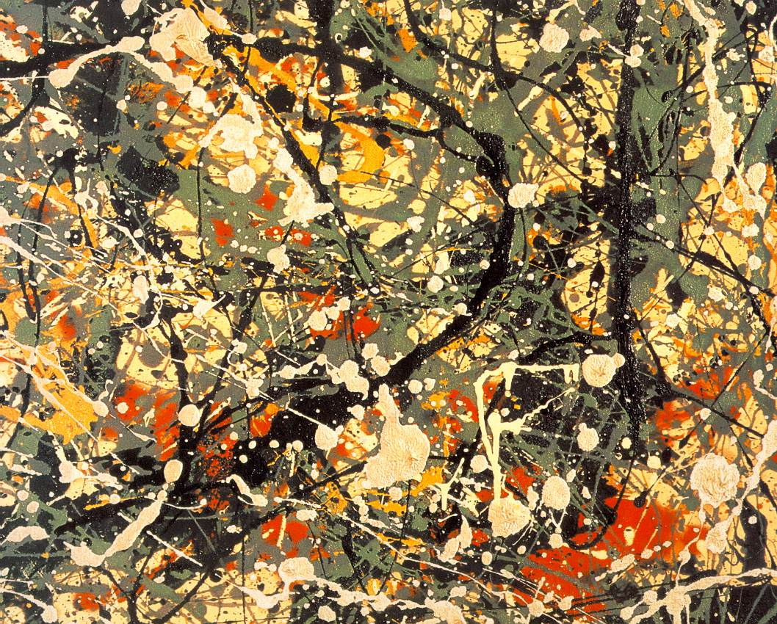
Culture & Research
Is it fine Art ?

Slide 5
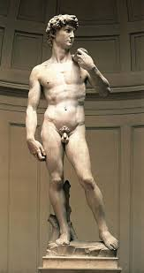
Culture & Research
Or a sculpture ?

Slide 6
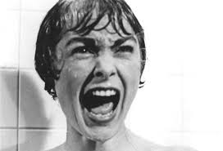
Culture & Research
For the purposes of this lecture the answer is NO!

Slide 7

Culture a definition:
Culture in the context of this paper can be seen as a set of shared
understandings.

Slide 8
Culture a definition:
Culture is knowledge, belief, art, morals, law customs acquired by a person as a member of society. Taylor(1871)

Slide 9
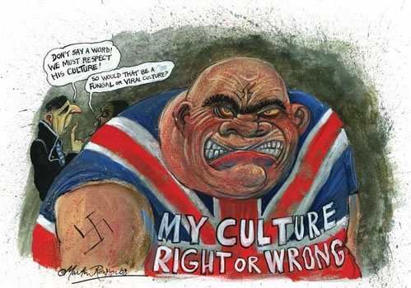
Sub-Cultures
Are those groups that reside within the main culture – People can be members of more than one sub-culture. They cannot as a rule live in more than one dominant culture.

Slide 10
Sub-Cultures
A sub-culture generally hold the majority of beliefs of the main culture but will also have a another set of beliefs that is particular to that sub-culture.

Slide 11
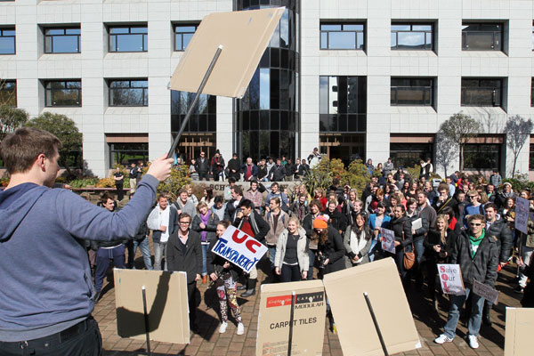

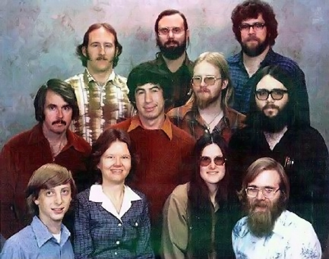




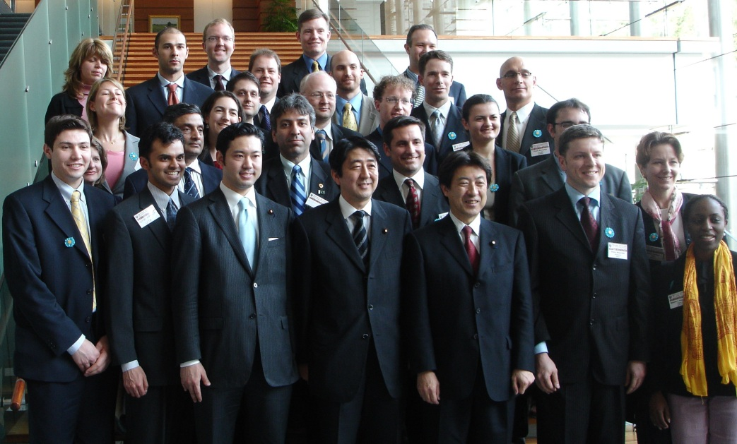
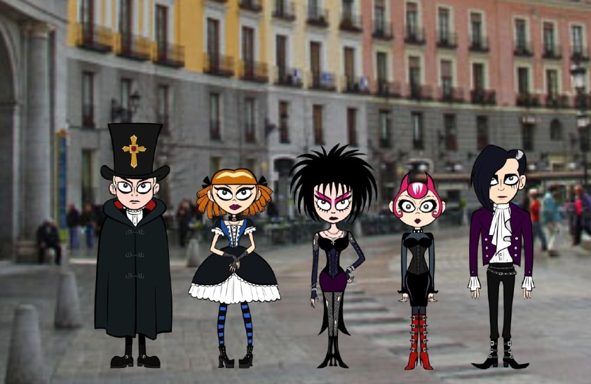
Sub-Cultures
Examples of sub-cultures

Slide 12

Sub-Cultures
Another form of sub-culture is Organizational culture. We talk of Corporate Culture and how it affect workers in that company.

Slide 13

Sub-Cultures
Another form of sub-culture is the military.

Slide 14
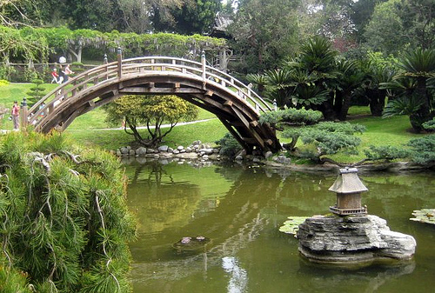
How does culture effect research?
Culture affects our day to day lives. It colours the way we think and respond to an incident. How we think and to extent show our emotions.

Slide 15
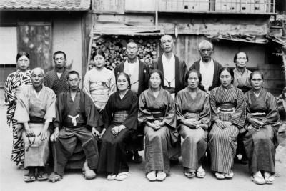

How does culture effect research?
For example look at anger, how do we show when are angry, compare this reaction to an older Japanese person.

Slide 16

How does culture effect research?
One must realise that the rules that hold a culture together can change with time and situations.

Slide 17
How does culture effect research?
Mental illness is perceived differently in different cultures.

Slide 18
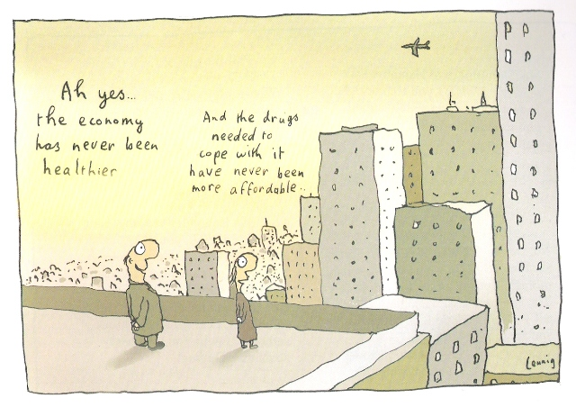
How does culture effect research?
The culture that we live in mandates how we should behave.
Michael Leuing

Slide 19
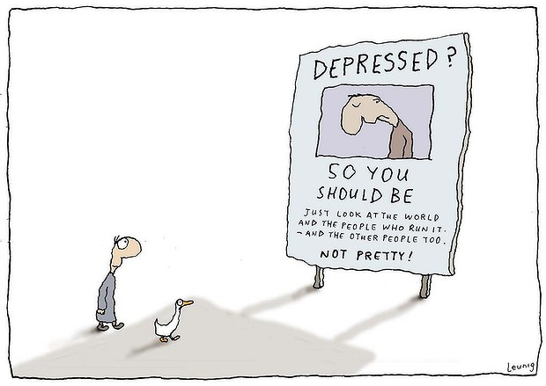
How does culture effect research?
When individuals do not conform to the behavioural standards of the culture they live in they are often called mad or insane.
Michael Leuing

Slide 20
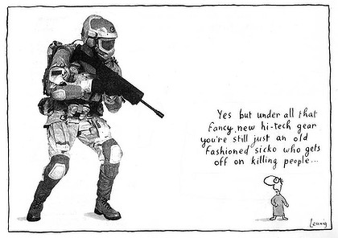
How does culture effect research?
Insanity - a perfectly rational adjustment to an insane world. R.D. Laing
Michael Leuing

Slide 21
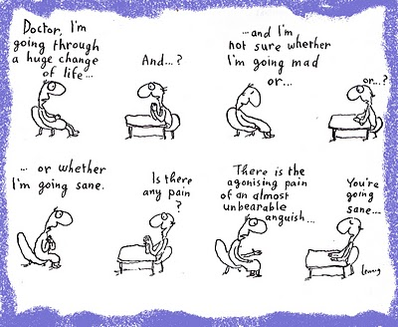
How does culture effect research?
People often say that this or that person has not found himself.
But self is not something that one finds. It something one creates. – Thomas Szasz
Michael Leuing

Slide 22

Culture and Research
So where does this leave us?

Slide 23

Culture and Research
If culture is what governs our life how and our behaviour. Should we blame everything on culture.

Slide 24
Culture and Research
The answer is its not just culture but a mixture of culture and individual differences. This is what makes us different for others.

Slide 25

Culture and Research
Culture does affects our attitudes to something.
It could be the colour of something or how something is phrased.

Slide 26
Culture and Research
Red :
China: Good luck, celebration, summoning
Cherokees: Success, triumph
India: Purity
South Africa: Color of mourning
Russia: Bolsheviks and Communism
Eastern: Worn by brides
Western: Excitement, danger, love, passion, stop,
Christmas (with green)

Slide 27
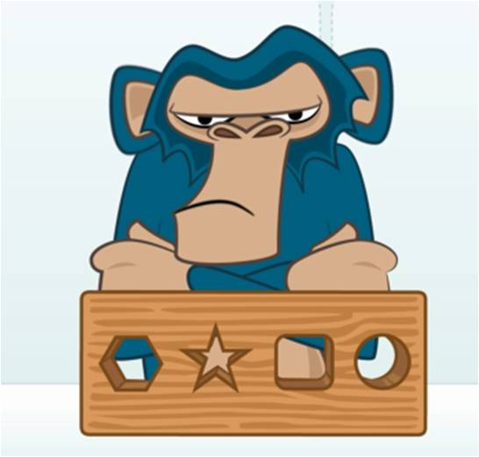
Culture and Research
So if culture colours the way we see the world then it must affect research in some way.

Slide 28

Culture and Research
Because it must be reflected in the answers that we give and how we give them.

Slide 29
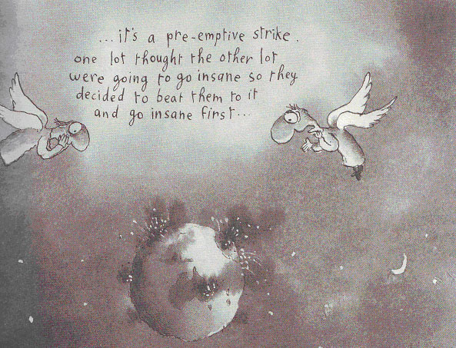

Conclusion

